Slide 1
23347 NTAKIRUTIMANA Elysee

Slide 2
TEACHER’S IMIHIGO INSPECTION SYSTEM
The role of teacher's Imihigo inspection, also known as classroom observation or teacher evaluation, is to assess and monitor the performance of teachers in educational settings:
Here are some KPI (Key performance Indicators) against teacher’s Imihigo Inspection system such as:
Attendance rate %
Graduation rate %

Slide 3
Here are steps I have followed to develop my spring mvc(Model-View-Controller) web application
Create new maven project by:
Open Intellij and select "File" -> "New" -> "Other".
In the "New" dialog box, expand the "Maven" folder and select "Maven Project". Click "Next".
In the "New Maven Project" dialog, specify the Group Id, Artifact Id, and Version for your project. These parameters help identify your project and generate a unique identifier for it.
Group Id: This identifies the organization or group to which the project belongs.
Artifact Id: This represents the unique name of the project.
Version: This specifies the version of your project.

Slide 4
When creating a Spring MVC project, there are several frameworks and best practices you can follow to enhance your development process and improve the overall structure and efficiency of your application.
Thymeleaf:it allow you to create dynamic web pages by combining HTML templates with server-side data.
Spring Security: If your application requires authentication and authorization, Spring Security provides robust security features.
Hibernate or Spring Data JPA: If your application interacts with a relational database, Hibernate or Spring Data JPA can simplify database operations.

Slide 5
Spring web: Spring Web provides a Model-View-Controller (MVC) architecture that allows for clear separation of concerns between the application's data, presentation, and user interaction.
Spring DevTools: this framework support remote development scenarios. It allows you to run your application on a remote server, provides automatic application restart capabilities.
Compatibility: chosen database driver must be compatible with the database management system (DBMS) you are using. Different databases (e.g., MySQL, PostgreSQL, Oracle, SQL Server) have their own specific drivers.

Slide 6
Configure the project dependencies by:
Open the project's pom.xml file.
Add the required Spring MVC dependencies, such as spring-webmvc, spring-core, spring-context, and any additional dependencies you need.
Save the pom.xml file, and the dependencies will be downloaded automatically.

Slide 7
When developing a Spring MVC project, you typically need to include several packages from the Spring framework such as:
controller
model
repository
service layer
a controller plays a crucial role in handling incoming HTTP requests, processing the requests, and returning an appropriate response to the client.

Slide 8
The main controller class is typically annotated with some annotations to indicate that it is responsible for handling HTTP requests and serving as a component of the MVC architecture.
@Controller: This annotation marks a class as a controller component in Spring MVC.
@RequestMapping: This annotation is used to define the base URL or URL patterns that the controller handles.
@GetMapping, @PostMapping, @PutMapping, @DeleteMapping: These annotations are used to handle specific HTTP methods (GET, POST, PUT, DELETE) for a given URL pattern.

Slide 9
a model represents the data that is passed between the controller and the view. It plays a crucial role in facilitating the exchange of information, enabling the controller to prepare the data and the view to render it appropriately.
repository is responsible for defining and implementing methods to access and manipulate data stored in the database.
The service layer plays a crucial role in implementing the business logic and coordinating the interactions between the controller and the repository (data access layer).

Slide 10
@PathVariable: This annotation is used to bind a URL variable to a method parameter. It extracts the value from the URL and maps it to the corresponding method argument.
Templates are responsible for rendering the dynamic content that is displayed to the user.
Templates use templating languages or frameworks (e.g., JSP, Thymeleaf, FreeMarker) to access and display the data received from the controller.

Slide 11
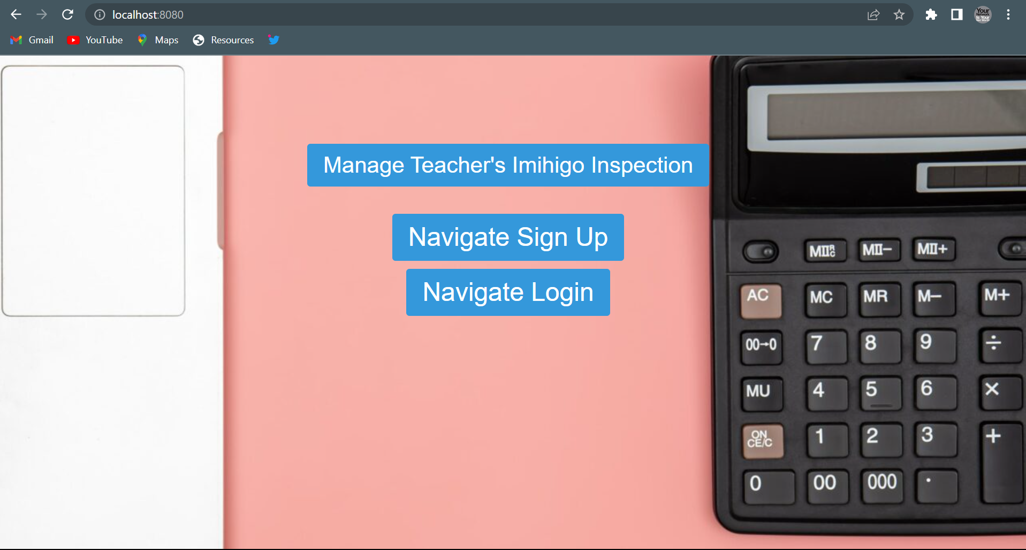
My home page view Rendering

Slide 12
This is the main entry point of my web application, it serves as the initial page that users see when they access the site.
Navigation links that allows you to manage my web application and gives access to sign up in case you are new user who do not have an account.
Navigation link that allows you to sign in case you are the user who have an account.
Navigation link that allows to manage all the contents in my web application.

Slide 13
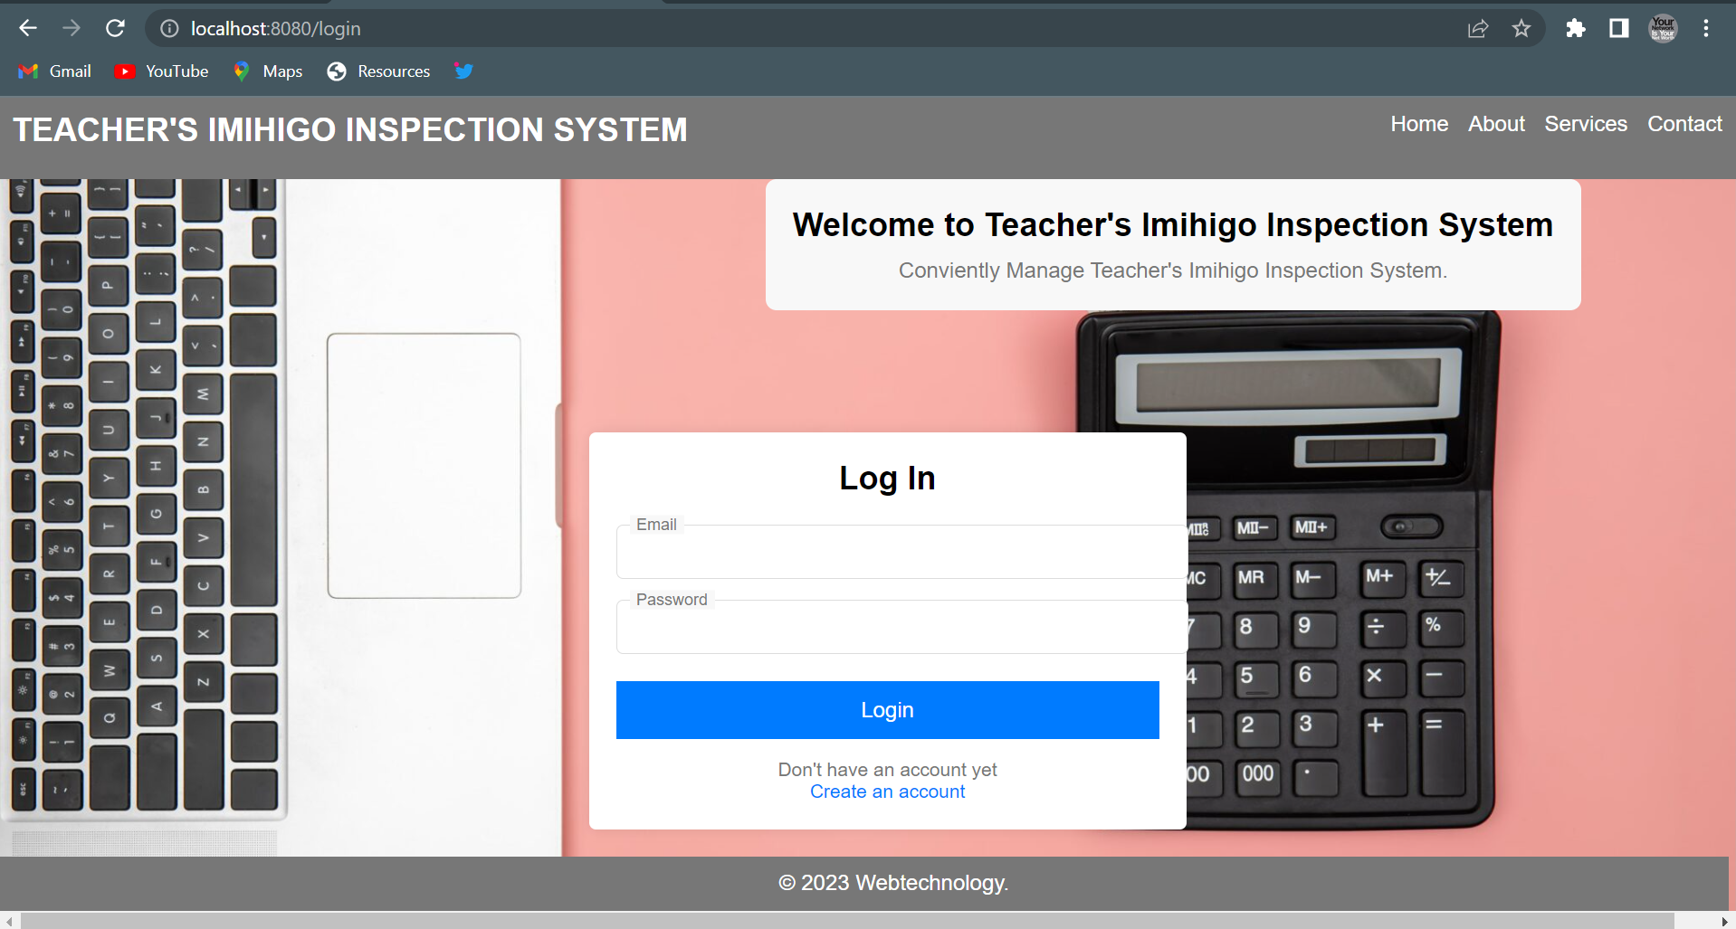
User authentication and access control to sign in

Slide 14
The login functionality verifies the identity of the user by authenticating their credentials, such as username and password.
It ensures that only authorized users can access protected resources and perform specific actions within the application.
Security and Protection:
The login process incorporates security measures, such as password hashing, encryption, and secure communication protocols (e.g., HTTPS), to protect user credentials and sensitive information.

Slide 15
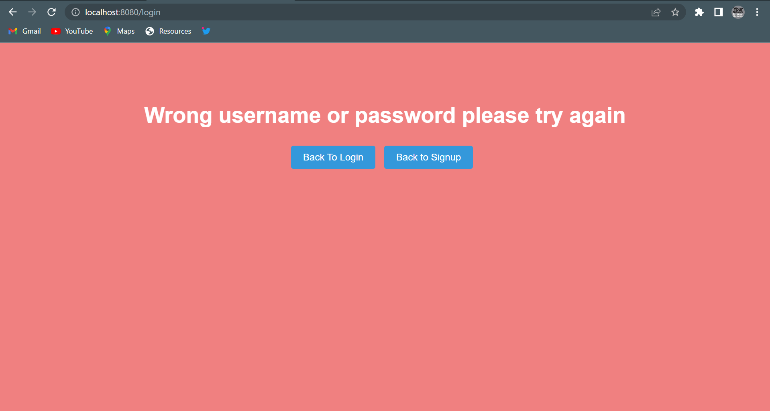

Slide 16
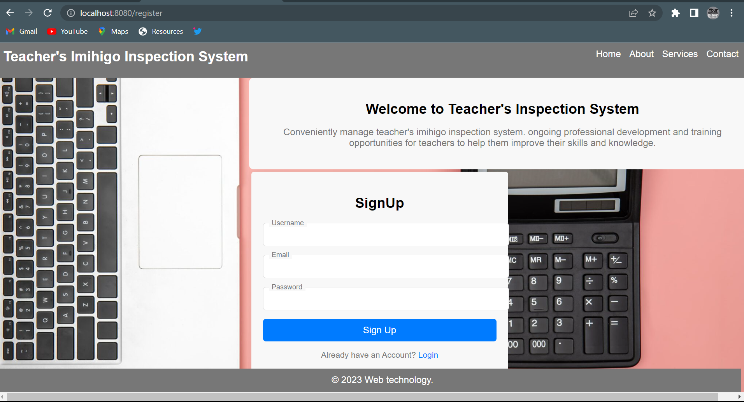
User registration and account creation( user profile set up)

Slide 17
The sign-up feature enables users to register themselves by providing necessary information, such as username, email address, and password.
It collects user details required to create a unique account and establish their identity within the application.
The sign-up functionality creates a new user account in the application's user management system or database.

Slide 18
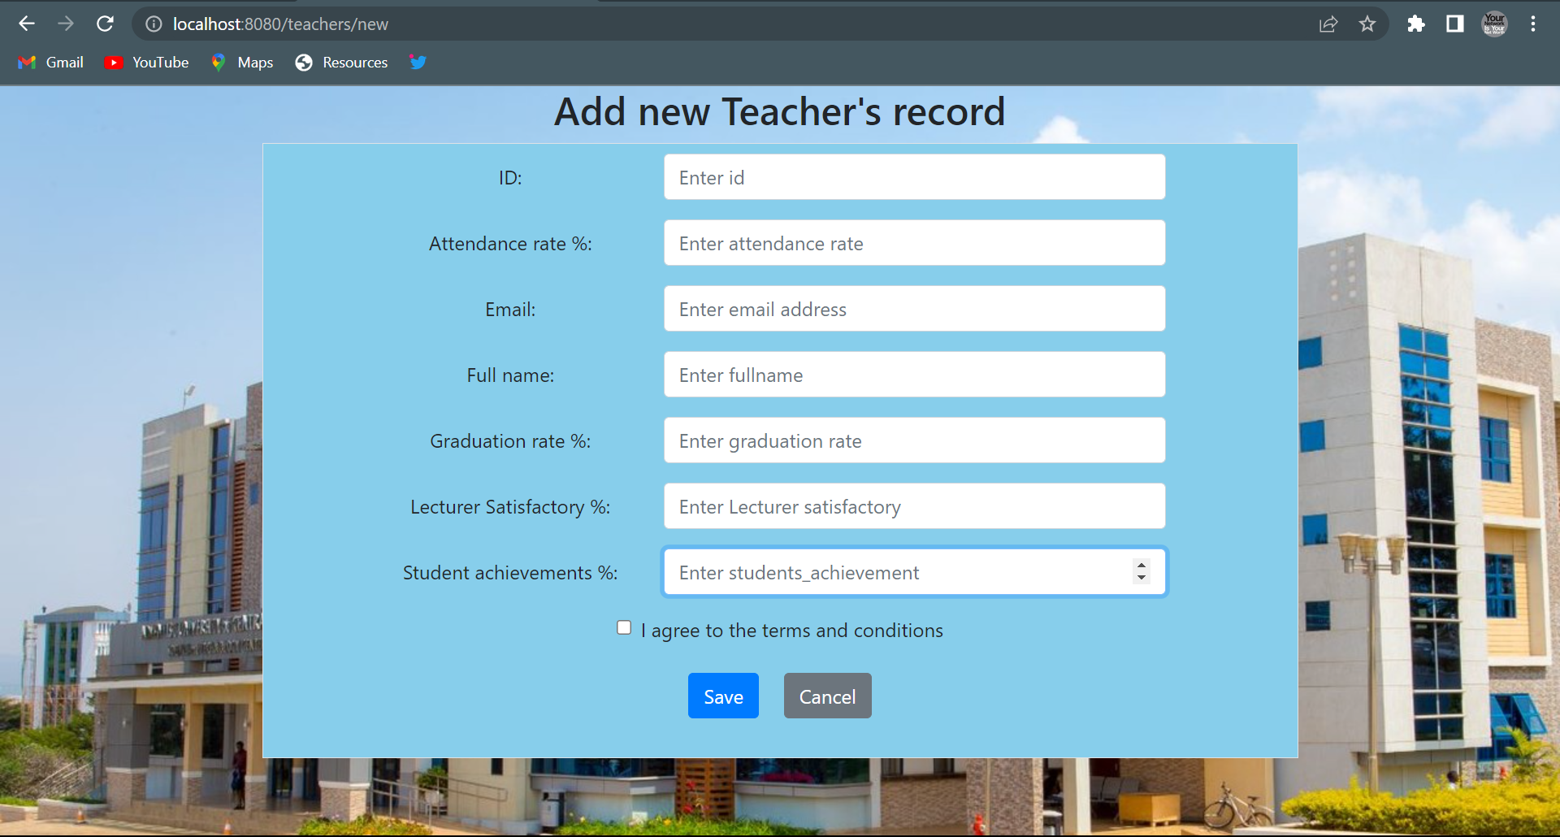
Application Submission and Data Management and Review:

Slide 19
This page page allows users to submit their applications electronically, eliminating the need for physical paperwork.
It provides a user-friendly interface where applicants can input their personal details, and other required informations such lecturer satisfactory and attendance rate and so on.
it validate and collects data that will be based on rating the lecturer of his/her performance.

Slide 20
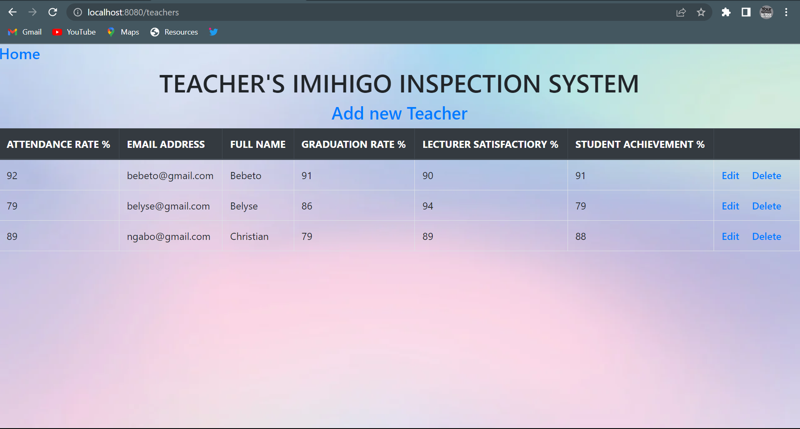
Data Retrieval and performance

Slide 21
This database enables the retrieval of stored data based on specific teacher’s criteria and performance.
it fetch the information dynamically and display it to the user or use it for further processing, it supports various operations like searching, sorting, filtering.

Slide 22
THANK YOU

